Slide 1
Administrative Poka-Yoke

Slide 2

Other Modules In This Series:
5S
Standard Work
Total Productive Maintenance (TPM)
Administrative Lean
Cell Design/ Production Preparation Process (3P)
Kaizen
Kanban
Problem Solving
Poka Yoke Quality Systems
Transaction Process Improvement (TPI)
Cause & Effect Diagram with the Additions of Cards (CEDAC)
Single Minute Exchange of Dies (SMED)
Value Stream Mapping (VSMi®)
Visual Management
Managing Daily Process Excellence
For More Information Please Contact:
Mark DeLuzio, President and CEO
+1.860.234.0915
mark.deluzio@leanhorizons.com
Strategically Creating Value Through the Elimination of Waste

Slide 3
This document contains confidential
and proprietary information owned
by Lean Horizons Consulting, LLC.
Any disclosure, use, copying or
distribution of this information without the express written consent of Lean Horizons Consulting is strictly prohibited.

Slide 4
Ground Rules for Event
Safety first (use personal protective equipment)
Active participation by all
Start and end on time
All electronic gadgets (phones, pagers, etc) turned to “off” or “silent”
Computers to be used only when instructed
Keep an open mind to change
Don’t let “perfect” get in the way of “better”
Notes:
DO: Perform Group Introductions. Pick an ice-breaker or exercise to warm the team up to the event. (Icebreaker Example: Everyone uses their name tent and writes a “Personal License Plate” in which they have 2 minutes to creatively use a total of 7 letters or numbers to tell us something about themselves. Examples “LV2SAIL” OR “DADOV5”
DO: Review Event Ground Rules.
ASK: “Does anyone have any rules they would like to see added?”
ASK: “Does everyone agree to these?”

Slide 5
Goal of Poka-Yoke Module
To apply the principles and practices of Poka-Yoke to achieve an improved quality target goal for your business.
Introduction
to Poka-Yoke
7 Steps
of Poka-
Yoke
Poka-Yoke
Examples
Notes:
DO: Introduce the notion of Poka-Yoke and the goal of this event.
SAY: “In this module we want you to learn the difference between defects and errors, learn how poka-yoke is a vital element of improving product quality, and learn how to implement poka-yoke in your value streams.”

Slide 6
Introduction to Poka-Yoke
Introduction to Poka-Yoke
7 Steps of Poka-Yoke
Poka-Yoke Examples
Objectives:
Define poka-yoke
Identify the five elements of production
Review the four levels of error-proofing
Differentiate “defects” from “errors”
Identify sources of defects
Notes:
DO: Review section objectives on slide.

Slide 7
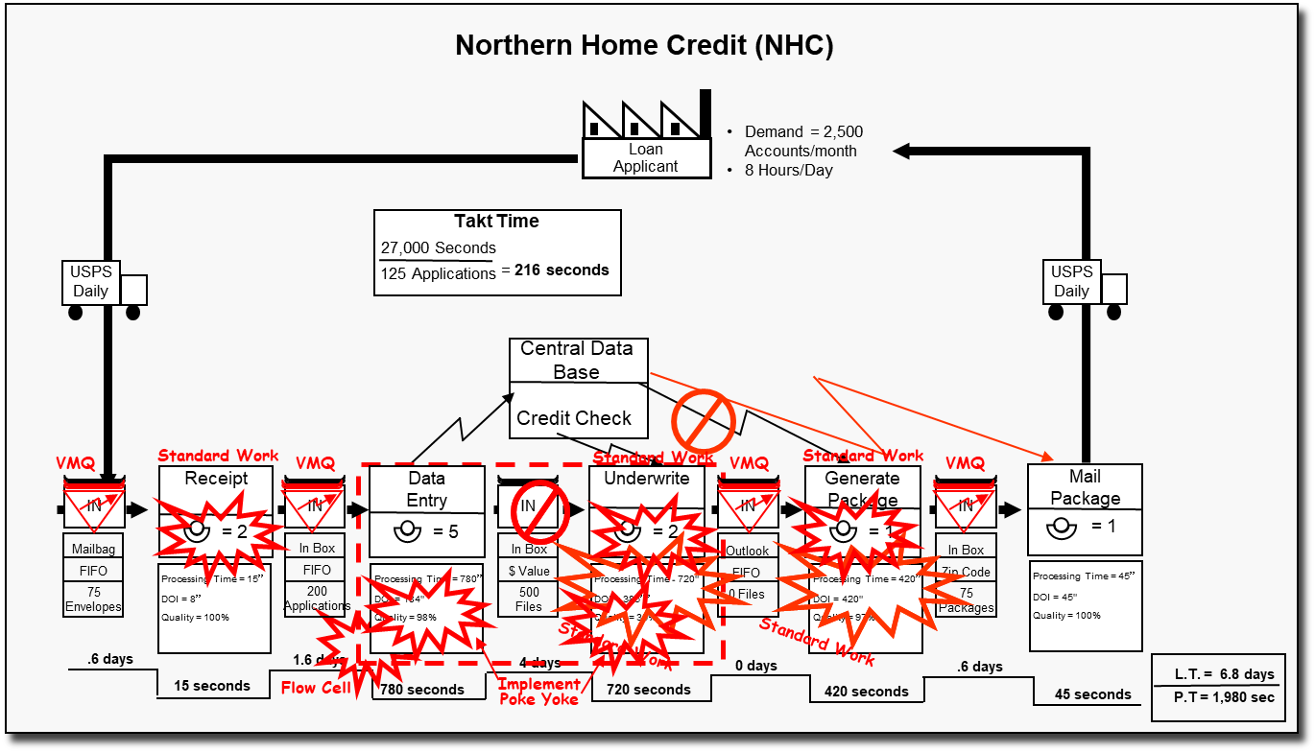
How did we get here?
Introduction
Notes:
SAY: “As with all kaizen, our direction for our improvement efforts should be driven by a business need and/or the tool Value Stream Mapping.”
ASK: “Why?”
SAY: “We want to make sure we are going to get our “bang for the buck” with the investment we are making in our improvement efforts.”
ASK: “What business need is being met with our kaizen event this week?”
ASK: “Is there a Value Stream Map or a Value Stream Plan that identifies the need for this event?”

Slide 8
Poka-Yoke: Error-Proofing
Introduction
1
2
3
Poka-Yoke
Jidoka
Examples
A Japanese term meaning, “mistake-proof”
  Inadvertent errors (Poka)
  To avoid (yokeru)
A method of designing processes that will prevent errors
Also referred to as “autonomation”, means a method of transferring human intelligence to the process
The process detects abnormalities and stops when detected
Motion detect light switches room enter and exit
Car stops when object in path.
Auto shut-off irons
Automatic sinks in public restrooms
Low clearance barriers in parking garage
Notes:
DO: Review the Japanese origins and definition of the term, poka-yoke.
SAY: “Poka Yoke is also called mistake-proofing, error-proofing, and baka-yoke (fool proofing)”
SAY: “Poka-Yoke refers to methods that help associates avoid mistakes in their work caused by choosing the wrong item, leaving out an item, or any other form of doing something incorrectly.”
SAY: “ Jidoka is another Japanese term that refers to providing systems, programs, and associates the ability to detect when an abnormal condition has occurred and immediately stop work. This allows associates to build quality into each process of their work.”
ASK: “What are other error proofing examples?”
Car safety belt warning light or buzzer
Clothes iron that shuts itself off if left on inadvertently
Garage door opener with safety reversing switch
Lawn mower with safety release handle for shutting off mower
A car that cannot be started in gear
Microwave ovens that will not start with the door open

Slide 9
Poka-Yoke Philosophy
Introduction
Promotes defect prevention vs. defect detection
Recognizes that people forget and make errors, and machines and processes fail and make errors
Respects the intelligence of workers by taking the judgment out of repetitive tasks or actions where errors are likely to occur
Utilizes people working in the process to “mistake-proof” the process because they own the process
Notes:
DO: Review key points on the slide. As if anyone has experience implementing poka-yokes in the workplace and if yes, to share.

Slide 10
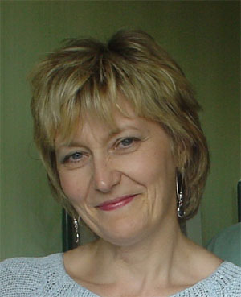
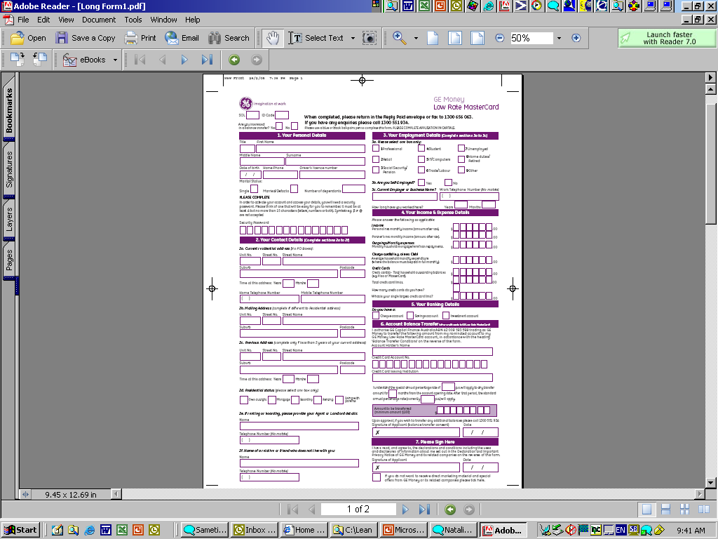
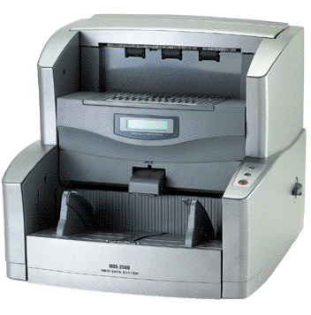
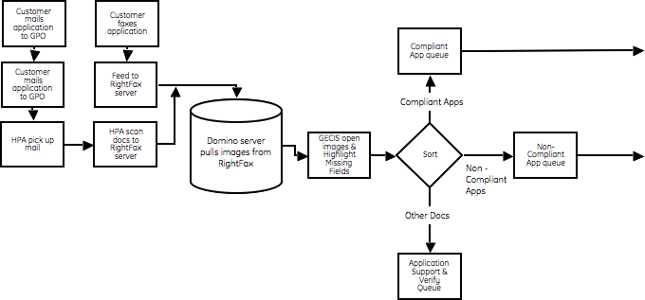

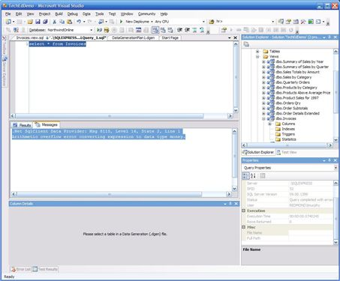
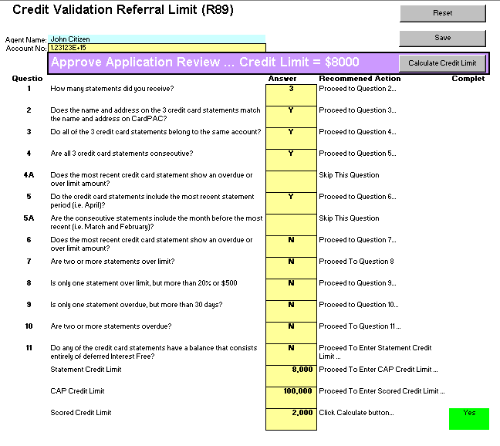
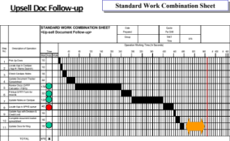
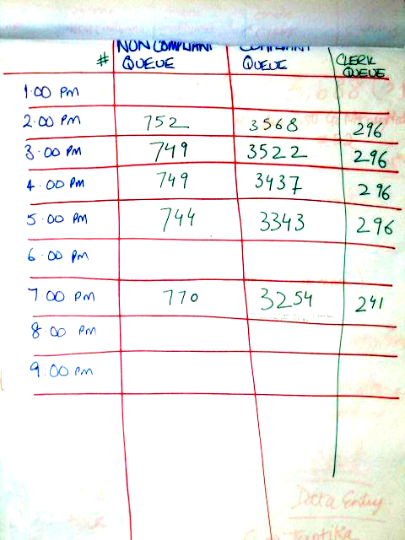
The Five Elements of a Process
Introduction
1. ME
Control: Discipline, fundamental education, cross-training assignments
2. MATERIAL
Control: Source controls
3. MACHINE
Control: Conditions assured through everyone’s participation
4. METHOD
Control: Work standards
5. INFORMATION
Control: Visual controls (e.g.: instruction sheets, visually managed queues)
Notes:
SAY: “The five elements of production are Me (the operator), Material, Machine, Method, and Information. Each one of these elements has the capability of introducing variation into the process that can result in poor quality. When we error-proof a process, we want to take each of these five elements into consideration so that we can achieve process control.”

Slide 11
Why is Poka-Yoke an important concept?
Introduction
Key element in our capability to eliminate waste
No need for “just in case” inspections
Allows company to process only what the customer needs
Maintain customer satisfaction and loyalty
Happy customers mean more sales
Always a cost associated with defects and rework
Notes:
SAY: “Poka-Yoke is a key element in our capability to implement Kaizen-Lean Manufacturing Systems. It is a key element in our capability to eliminate waste from: defects, inventories, motions, delays, processes, misused resources, untapped resources.”
SAY: “Consistency in quality will result in maintaining customer satisfaction and loyalty.”
SAY: “Think about all of the costs for producing defective work or errors. There are tremendous costs associated with re-work, materials, equipment expenses, shipping – not to mention the damage that happens to our relationship with our customers and how our products and brand are viewed.”

Slide 12
Exercise: Poka-Yoke Charter Review
Introduction
Objective
Review the Poka-Yoke Charter for the event against charter criteria
Instructions
Time to Complete
As a team review the event charter and answer the following questions:
What is the business need for this event?
Who is the owner?
What are the goals for this event?
30 minutes
Deliverable
Make any modifications
to charter as necessary.
Notes:
DO: Review the charter for this event.

Slide 13
Discussion
Introduction
Objective
Discuss the difference between “defects” and “errors”
Instructions
Time to Complete
In pairs, discuss what you think the difference is between the terms “defects” and “errors”.
Discuss answers as a class
3 minutes
Deliverable
Class discussion of
answers
Notes:
DO: Have the class discuss the exercise in pairs and prepare their answers, or conduct this exercise as a large group calling upon people to share their answers.
SAY: “Defects are a result of errors that are made – so if you can reduce or eliminate the potential for error, you do the same for the potential for defects.”

Slide 14
What causes defects?
Introduction
1. Poor Procedures
or Standards
Human Mistakes:
Simple errors, the most common cause of defects, occur unpredictably
Ten Types of Human Mistakes:
  Forgetfulness
  Misunderstanding
  Wrong Identification
  Lack of Experience
  Willful ignoring
  Inadvertent or sloppiness
  Slowness
  Lack of standardization
  Surprise
  Intentional
2. Equipment
3. Non-conforming Material
4. Inaccurate Information
5. Human Mistakes
Notes:
SAY: “Human mistakes are the most common cause of defects.”
DO: Review the 10 types of human mistakes.
ASK: “Can you think of a daily process at work or at home that human mistakes are often made? What could be done to prevent those errors from happening?”
SAY: “Our processes need to be designed to account for this fact, so that mistakes are not made or passed along.”

Slide 15
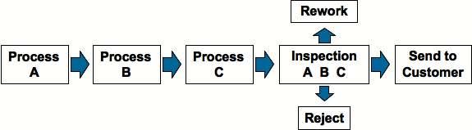
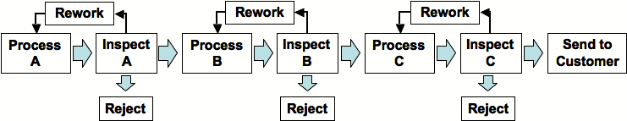
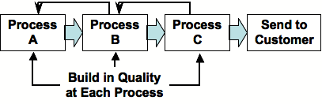
Error-Proofing
Introduction
Level 1 - Customer Inspects
Level 2 - End of Value Stream Inspection
Level 3 - End of Process Inspection
Level 4 - Perfect Quality Built In
Poka-Yoke
Notes:
DO: Review the 4 levels of error proofing.
SAY: “At the “Customer Inspects level, we are still allowing defects to get into the hands of customers.”
ASK: “What is wrong with stopping at Level 2? (we are waiting until after the 3rd process to check if we have a quality part… steps B and C could be working on defect (WASTE – and if they are working in batch even more so!)
SAY: At level 3 we are getting much better by inspecting at the end of each process (however we are adding time and resources to do so at every point).
SAY: “We want to reach a point (Level 4) where it is impossible to pass a defect onto the next process. In this section will discuss ways to build quality into the product so that we can achieve this.”

Slide 16
Discussion
Introduction
Objective
Discuss error-proofing examples in your everyday environment.
Instructions
Time to Complete
In pairs, list examples of devices or mechanisms in your everyday environment designed to prevent errors.
How do these devices prevent the occurrence of a defect or a mistake?
Discuss answers as a class.
10 minutes
Deliverable
Class discussion of
answers
Notes:
DO: Have the class discuss the exercise in pairs and prepare their answers, or conduct this exercise as a large group calling upon people to share their answers.
NOTE: Participants may list devices or mechanisms designed to error-proof, but that still allow us to pass along a defect or allow for an error to be made. Use this opportunity to clarify the definition of poka-yoke.

Slide 17
The 7 Steps of Poka-Yoke
Introduction to Poka-Yoke
7 Steps of Poka-Yoke
Poka-Yoke Examples
Objectives:
Identify the 7 steps of the Poka-Yoke process
Define and identify Red Flag conditions
Differentiate between prevention and detection error-proofing techniques
Discuss importance of developing a Process Stop Support Plan
Discuss use of visual controls when error-proofing is not possible
Notes:
DO: Review section objectives on slide.

Slide 18
7 Steps of Poka-Yoke
7 Steps of Poka-Yoke
Create a process map and identify the locations at which the defects are found and made
Evaluate current procedures for adequacy and determine if they are
being followed
Identify defect provoking conditions, or red flag conditions, at each
process step
Identify the root cause(s) (error) of each type of defect and in which process step it occurs
Identify the type of error-proofing device required
Create the device and try it
Measure for effectiveness
Notes:
DO: Review the seven steps.

Slide 19
Red Flag Conditions are conditions which normally provoke errors
7 Steps of Poka-Yoke
Multiple steps
Infrequent processing
Lack of standards
Rapid repetition
High volume
Environmental conditions
  Material / process handling
  Housekeeping
  Ergonomics
Notes:
DO: Review Red Flag conditions.

Slide 20
Red Flag Conditions (continued)
7 Steps of Poka-Yoke
Adjustments
  Machines
  Programs
Templates / template changes
Low tolerance
Many transactions / Mixed transactions
Symmetry / Asymmetry
Notes:
DO: Review Red Flag conditions.

Slide 21
Errors may either be prevented or detected
7 Steps of Poka-Yoke
Technique | Prevention | Detection
Control (shut down) | An error is impossible | Defective item can’t move on to the next step
Warning | An error is about to be made | An error has been made
Notes:
SAY: “With error-proofing we can implement a control/shut down technique in the process – with prevention an error would be impossible, with detection, the defect would be unable to move onto the next step.
By implementing a warning technique, prevention methods would allow us to know that an error is about to be made, and detection methods would let us know that an error has just occurred.”

Slide 22


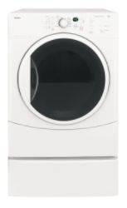
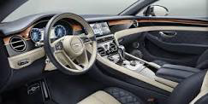
Control (Shutdown) Prevention and Detection Examples
7 Steps of Poka-Yoke
Prevention
Detection
Access controlled by biometric scan
Vehicle won’t start unless in park and brake depressed.
Laundry dryers that have a device that shuts them down when overheating is detected
A computer spell checker
Reprinted with permission from BigPhotoStock.com
Notes:
DO: Review examples.
ASK: “Are there others that you can think of?”

Slide 23
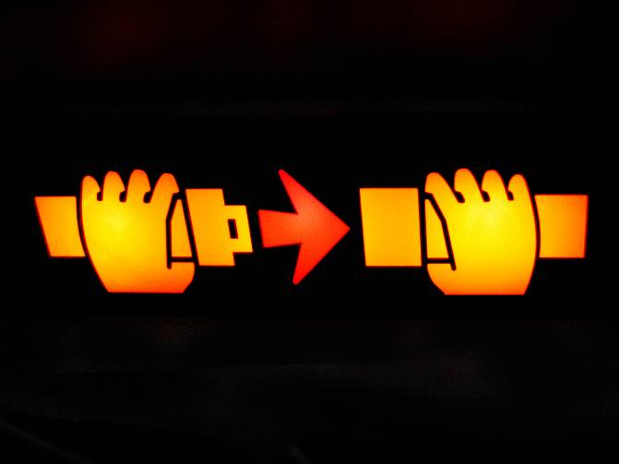
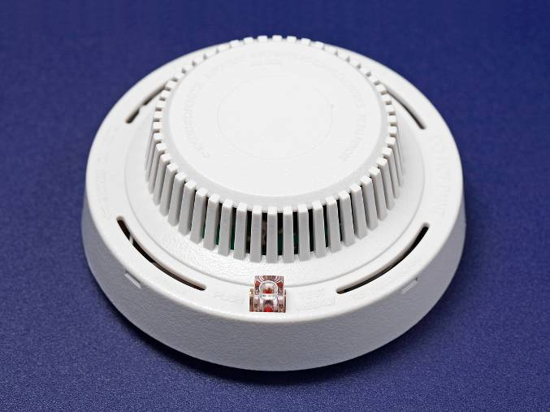
Warning Prevention and Detection Examples
7 Steps of Poka-Yoke
Prevention
Detection
Warning systems in automobiles to alert driver that not all seatbelts have
been fastened
Smoke detectors
Reprinted with permission from BigPhotoStock.com
Notes:
DO: Review examples.
ASK: “Are there others that you can think of?”

Slide 24
Error-Proofing Summary
7 Steps of Poka-Yoke
Error-Proofing devices can
  Prevent errors from occurring
  Detect the error after it occurred
  Detect the defect after it has been made
The best error-proofing devices are
  Simple and cheap
  Part of the regular process
  Close to where the error is made
Notes:
DO: Review summary points.

Slide 25
Poka-Yoke Examples
Introduction to Poka-Yoke
7 Steps of Poka-Yoke
Poka-Yoke Examples
Objectives:
Identify types of poka-yokes
Review various poka-yoke examples
Review key learnings
Notes:
DO: Review section objectives on slide.

Slide 26

Types of Poka-yoke Devices for the Office
Poka-Yoke Examples
Computer/Data Entry
Field Checks:
  Part Numbers vs. Database
  SS Numbers
  Date Check
Form Completion Verification
Password Protection
Automated Backups
Notes:
ASK: “What types of poka-yokes have you seen when conducting on-line ordering or data entry?” (drop down boxes, zip code validation of city, double entry of password, no submission if mandatory fields not completed…)

Slide 27

Types of Poka-yoke Devices for the Office
Poka-Yoke Examples
Checklists
Standardized, pre-designed
Eliminates missed steps, parts, etc.
Provides documentation of process quality
High correlation to quality improvement in rather complicated processes
Notes:
SAY: “While checklists do not assure that a mistake cannot be made, they significantly reduce the amount of errors and can provide standardized work.”

Slide 28
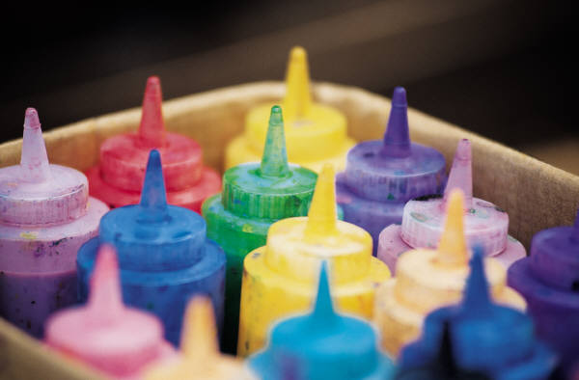
Types of Poka-yoke Devices for the Office
Poka-Yoke Examples
Color Coding
Provides visual control of process
Easy separation of similar process output
  Red Credit Memo
  Black Invoice
  Yellow Packing List
Easily detect when process is not in control
Notes:
SAY: “Again, color-coding does not completely error-proof a process, but it reduces errors and improves quality significantly.”

Slide 29
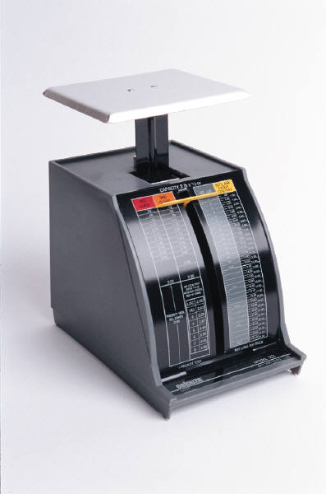
Types of Poka-yoke Devices for the Office
Poka-Yoke Examples
Sizes and Weights
Weights:
  Easily detect if a parcel contains
  the required contents
Sizes:
  Standardized sizes provide for visual control and detection of process errors
    Applications are different sizes for different classification of customers
    Different sized folders used for process variations
Notes:
SAY: “How have you seen this used?”

Slide 30
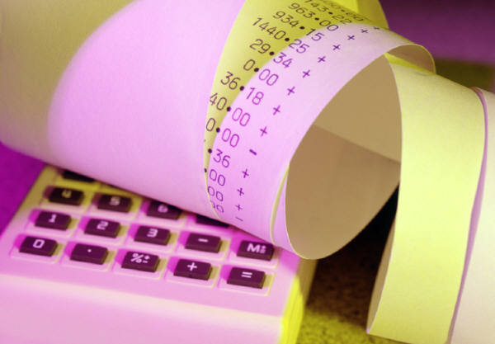
Types of Poka-yoke Devices for the Office
Poka-Yoke Examples
Batch Totals
Detects and eliminates data entry errors
Extremely useful in Accounts Payable or other batch processing applications
Error can still occur if source data is incorrect!

Slide 31
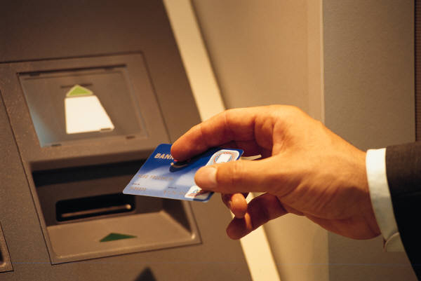
Types of Poka-yoke Devices for the Office
Poka-Yoke Examples
Electronic Cards
Pre-programmed data
Eliminates data entry errors
Password protection can eliminate fraud
Potential uses:
  Building security
  Financial transactions
  Time tracking and reporting
  Company expense report control
  Identification verification
Notes:
ASK: “How have you seen the spread of this technology?”

Slide 32
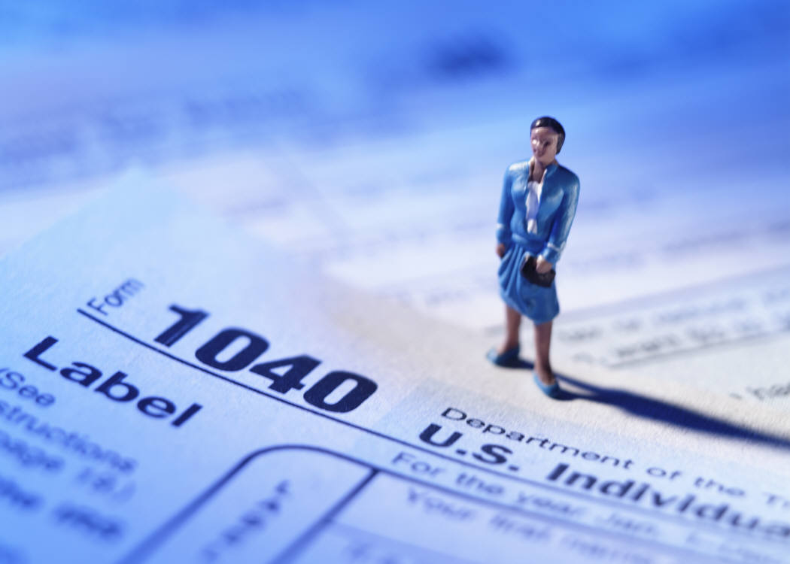
Types of Poka-yoke Devices for the Office
Poka-Yoke Examples
Standardized Forms
Eliminates errors of omission
Provides for repeatable quality input/output
Easily sorted based on data fields
Printing of form could be tied to the completeness of the document

Slide 33
Types of Poka-yoke Devices for the Office
Poka-Yoke Examples
Standardized Templates
Assures that all required materials or parts are processed
Used in shipping materials/forms to a customer where there is high level of complexity and errors are frequent
Badge
Point of Sale
Material
Credit Slips
Applications
Store Signs

Slide 34
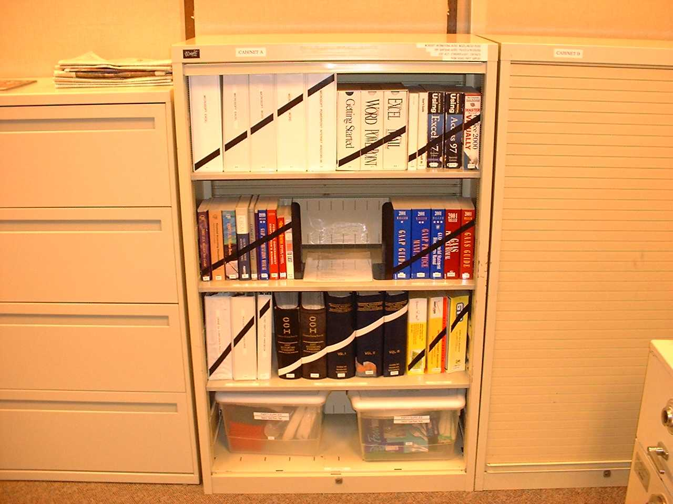
Types of Poka-yoke Devices for the Office
Poka-Yoke Examples
5S Organization
Organization eliminates errors
Makes things easy to find
Easy to detect when something is missing
Greatly improves productivity, quality, customer service
Notes:
ASK: “How does the example in this picture prevent errors? Do you currently have any examples of 5S or visual management in your office?”

Slide 35
Exercise: Determine Opportunities for Poka-Yoke
Poka-Yoke Examples
Objective
Determine opportunities for Poka-Yoke in your organization.
Instructions
Time to Complete
Use the chart on the following page as a guide to identify areas of opportunity to implement poka-yokes.
Return to the group and prioritize based on event charter and goals.
45 minutes
Deliverable
Review of listing

Slide 36
Exercise: Determine Opportunities for Poka-yoke
Poka-Yoke Examples
Area/Department | Describe Defect (Red Flag Conditions) | Recommend Poka-yoke Solution
Finance | Overpaying invoices due to keypunch errors on invoices | Batch Control Totals

Slide 37
Review Exercise
Poka-Yoke Examples
2 Minute Review
  In pairs, or in small groups, spend 5 minutes discussing key learnings and take-aways from this Poka-yoke Event thus far
  One person from each group will share one learning that was discussed with the rest of the class

Slide 38
Summary
Poka-Yoke Examples
Build quality into the process
All processes can become error free
Seek out the root cause
Look for Red Flag Conditions
Poka-yoke is a change in attitude

Slide 39
Other Modules In This Series:
5S
Standard Work
Total Productive Maintenance (TPM)
Administrative Lean
Cell Design/ Production Preparation Process (3P)
Kaizen
Kanban
Problem Solving
Poka Yoke Quality Systems
Transaction Process Improvement (TPI)
Cause & Effect Diagram with the Additions of Cards (CEDAC)
Single Minute Exchange of Dies (SMED)
Value Stream Mapping (VSMi®)
Visual Management
Managing Daily Process Excellence
For More Information Please Contact:
Mark DeLuzio, President and CEO
+1.860.234.0915
mark.deluzio@leanhorizons.com
Strategically Creating Value Through the Elimination of Waste

